Slide 1


EECT 111 – 50C Lab Notebook: Circuit Analysis
May 7, 2015
Olivia Koehler

Slide 2

Lab Notebook – EECT 111 Table of Content
Lab 1 – Resistors
Lab 2 – Resistor Color Codes
Lab 3 – Series Resistors, Current,
and Voltage
Lab 4 – Series Resistors
Lab 5 – Parallel Black Box Design
Lab 6 – N/A
Lab 7 – Resistor Parallel Circuit
Lab 8 – Black Box 3 Design
Lab 9 – Series/Parallel Resistors
Lab 10 – Series/Parallel Capacitance
Lab 11 – RC Lab
Lab 12 – Series/Parallel Inductors

Slide 3


Lab 1 – Resistor Variability
Star Date: 1/15/15

Slide 4

Lab 1 – Resistor Variability
Purpose: To learn how resistors differ based on their color code.
Equipment/Material: 10 resistors of the same color code & a Digital Multimeter (DMM).
Procedure: The leads of a DMM were placed onto either side of each individual resistor. The resulting display showed the actual value of the resister levels in Ohms. Then determined how closely each resistor matched their indicated color-codes.

Slide 5
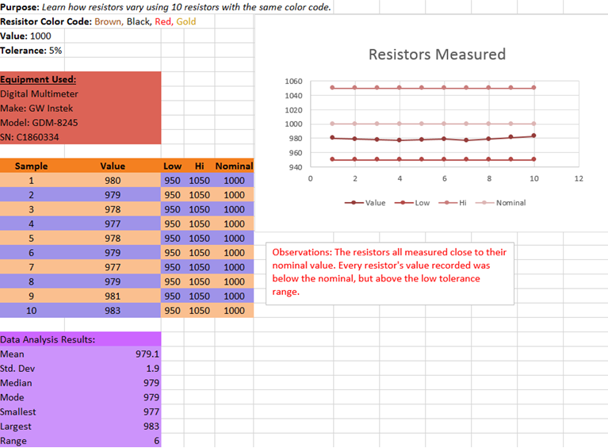
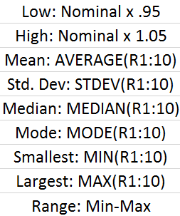
Lab 1 – Resistor Variability (Calculations & Measurements)

Slide 6
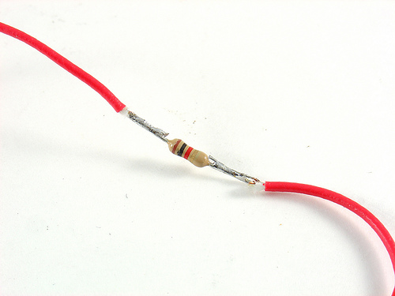
Lab 1 – Resistor Variability (Pictures)

Slide 7

Lab 1 – Resistor Variability (Conclusion)
Both calculations and measurements agreed with one another. All resistors measured close to their nominal value. Every resistor's value recorded was below the nominal, but above the low tolerance range.

Slide 8
Lab 2 - Reading and Sorting Resistors
Star Date: 1/29/15

Slide 9
Lab 2 - Reading and Sorting Resistors
Purpose: To understand resistor color-coding, using 15 different types of resistors.
Equipment/Material: 15 resistors of various values & Digital Multimeter. (DMM)
Procedure: Measured 15 resistors of various values with a DMM, and then sorted into ascending order. After which, the Min and Max values for each resistor were calculated using Excel.

Slide 10
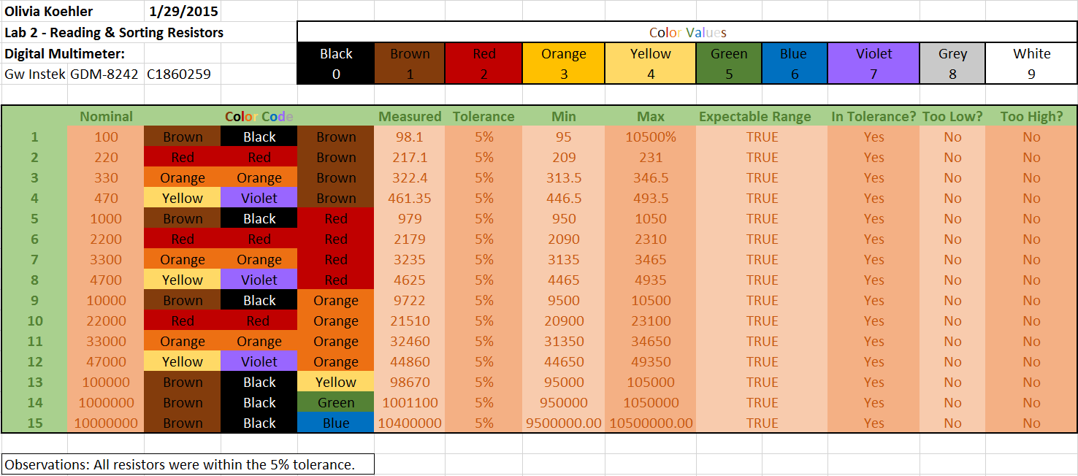
Lab 2 - Reading and Sorting Resistors (Calculations)

Slide 11
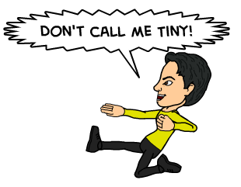

Lab 2 - Reading and Sorting Resistors (Measurements)

Slide 12
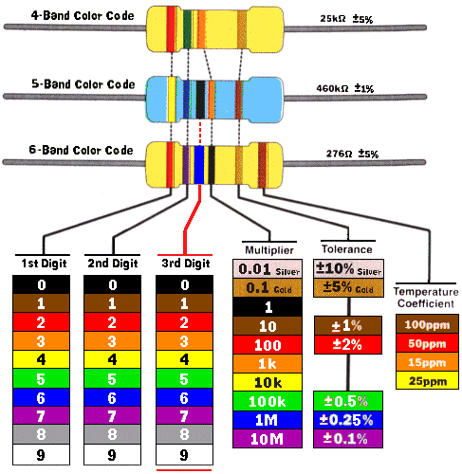
Lab 2 - Reading and Sorting Resistors (Pictures)

Slide 13

Lab 2 - Reading and Sorting Resistors (Conclusion)
All calculations and measurements agreed with one another. All resistors measured were within their 5% tolerance range.

Slide 14

Lab 3 - Series Resistors, Current, and Voltage
Star Date: 1/29/15

Slide 15
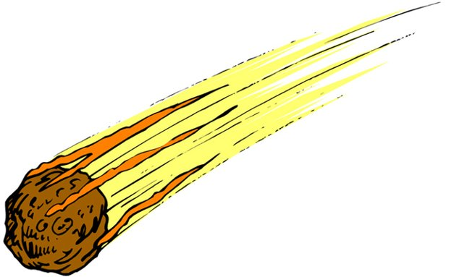
Lab 3 - Series Resistors, Current, and Voltage
Purpose: To experiment with series circuits and verify that the simulation, analysis (calculations) and measured test results all agree.
Equipment/Material: Resistors (10KΩ, 2.2kΩ & 4.7k Ω), Digital Multimeter & NI Elvis II+ Board.
Procedure: Three resistors are hooked together via NI Elvis II+ Board. Using a DMM, total resistance, voltage and current are found.

Slide 16
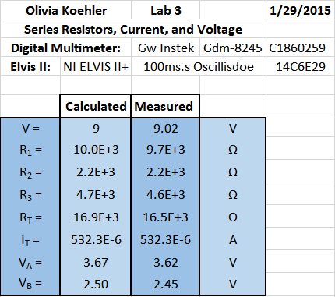

Lab 3 - Series Resistors, Current, and Voltage (Calculations)

Slide 17
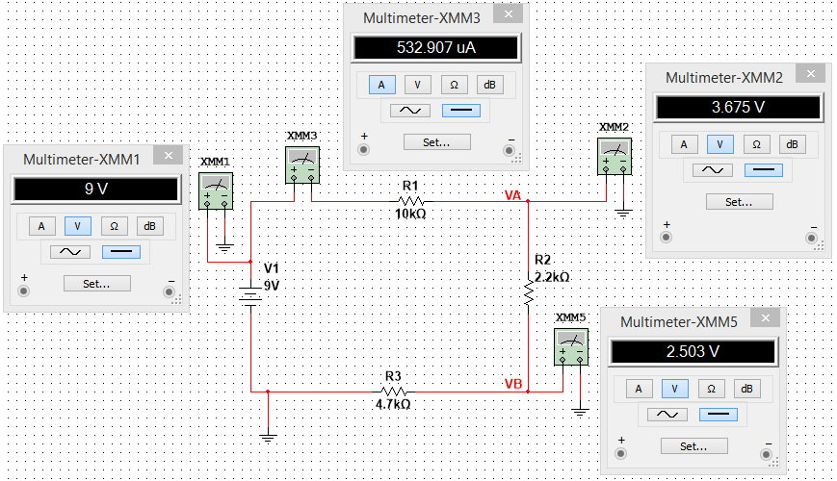
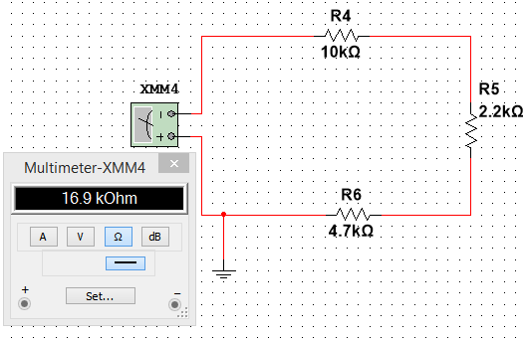
Lab 3 - Series Resistors, Current, and Voltage (Multisim)
V & I
R

Slide 18
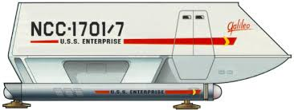
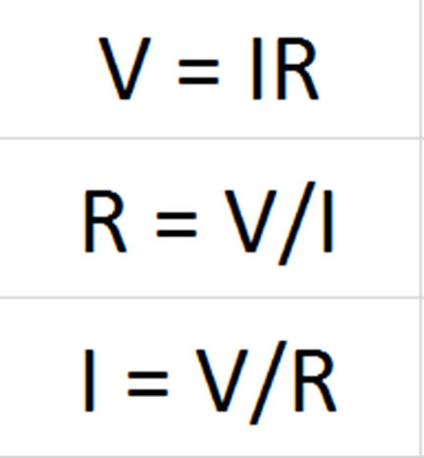
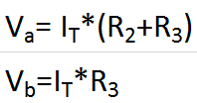
Lab 3 - Series Resistors, Current, and Voltage (Measurements)

Slide 19
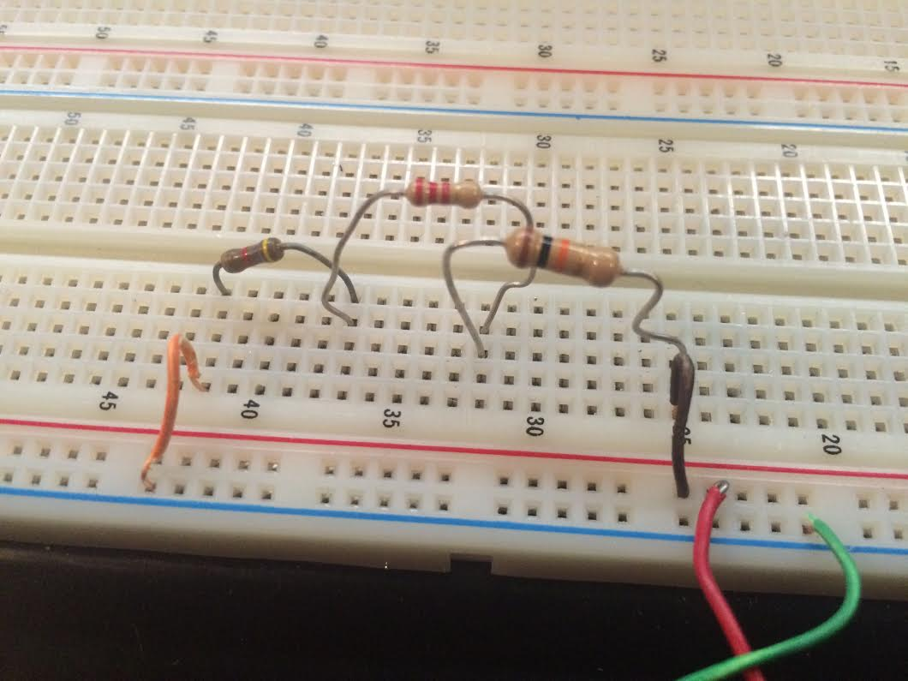
Lab 3 - Series Resistors, Current, and Voltage (Pictures)

Slide 20
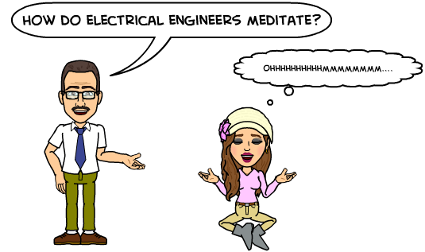
Lab 3 - Series Resistors, Current, and Voltage (Conclusion)
Calculations, Multisim, & measurements all lined up with one another. Through doing this experiment I learned that voltage, current and resistance all relate to one another.

Slide 21

Lab 4 – Series Black Box Design
Star Date: 2/12/15

Slide 22
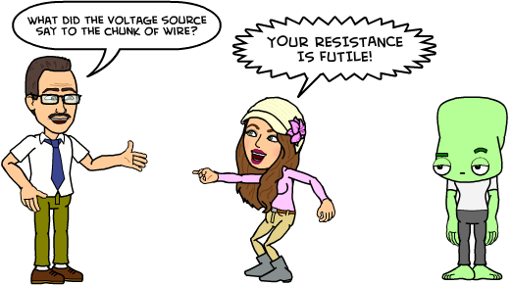
Lab 4 – Series Black Box Design
Purpose: To learn about and understand the series circuit.
Equipment/Material: Resistors (100Ω, 330Ω & 470Ω), Digital Multimeter & NI Elvis II+ Board.
Procedure: Knowing only current and voltage, find which three resistors, of standard value, are in series in the black box.

Slide 23
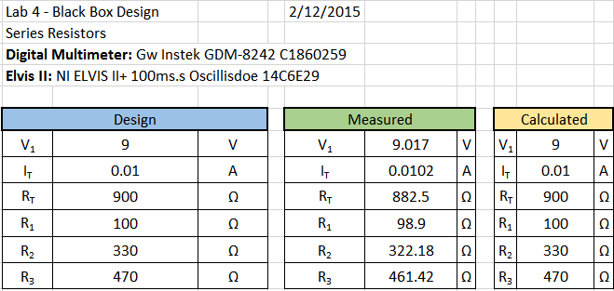
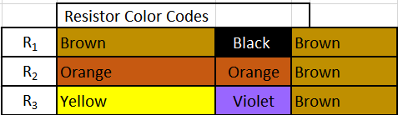
Lab 4 – Series Black Box Design (Calculations)

Slide 24
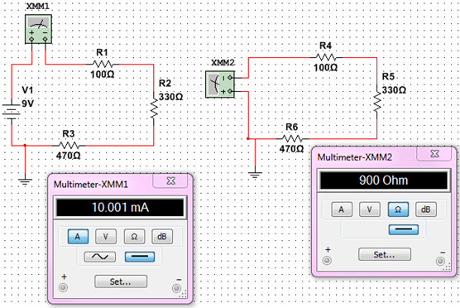
Lab 4 – Series Black Box Design (Multisim)

Slide 25
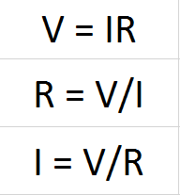
Lab 4 – Series Black Box Design (Measurements)

Slide 26
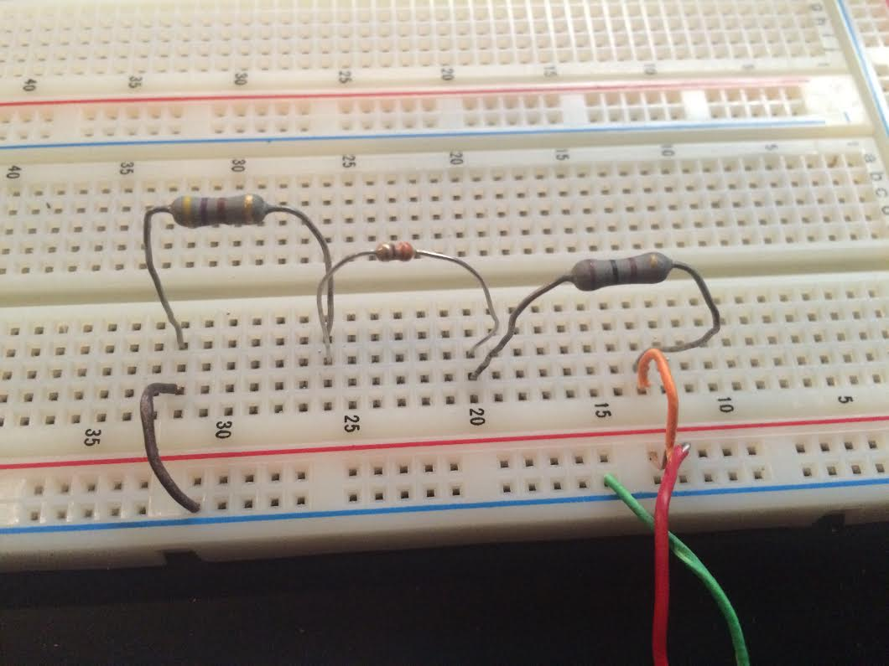
Lab 4 – Series Black Box Design (Pictures)

Slide 27
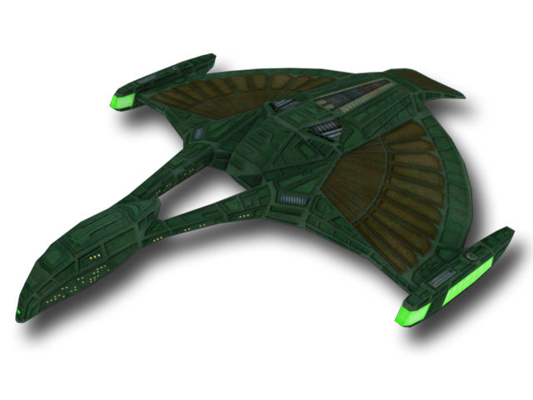
Lab 4 – Series Black Box Design (Conclusion)
All calculations, Multisim and measurements agreed with one another. I learned that it may seem like the options are infinite when it comes to finding a black box resistance. However, when one is trying to find total resistance using standard resistor values, suddenly the options become limited.

Slide 28

Lab 5 – Parallel Black Box Design
Star Date: 2/19/15

Slide 29
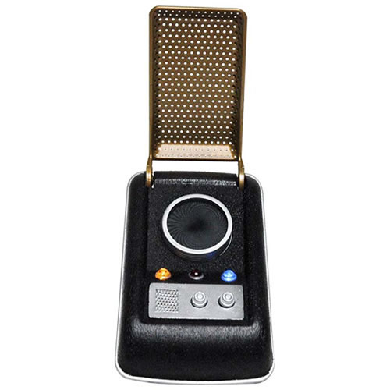
Lab 5 – Parallel Black Box Design
Purpose: To learn about and understand a parallel circuit.
Equipment/Material: Many differing resistor values, Digital Multimeter & NI Elvis II+ Board.
Procedure: Knowing only current and voltage, one must discover which resistors, of standard value, are in parallel in the black box.

Slide 30
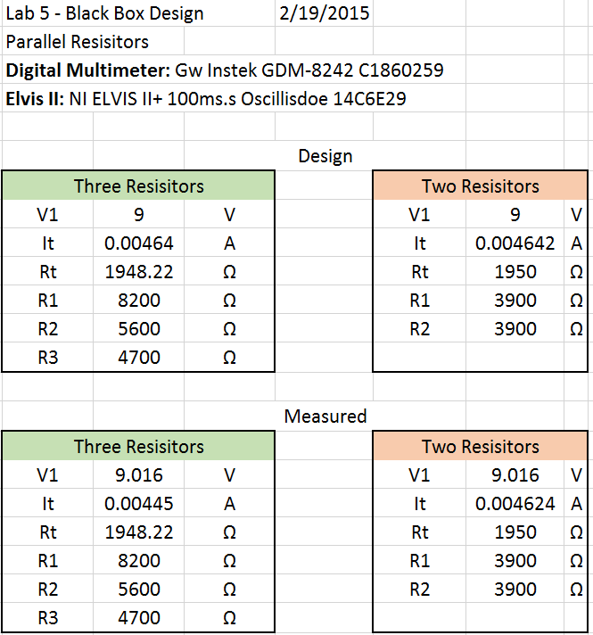
Lab 5 – Parallel Black Box Design (Calculations)

Slide 31
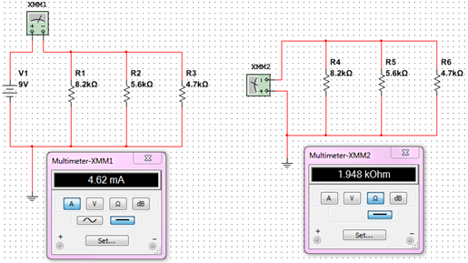
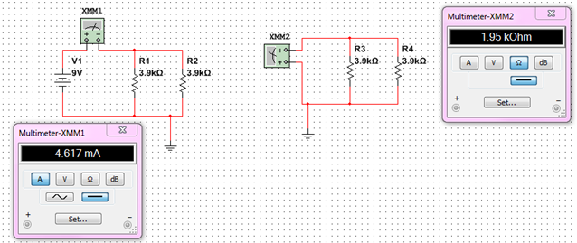
Lab 5 – Parallel Black Box Design (Multisim)
Two Resistors
Three Resistors

Slide 32

Lab 5 – Parallel Black Box Design (Measurements)

Slide 33
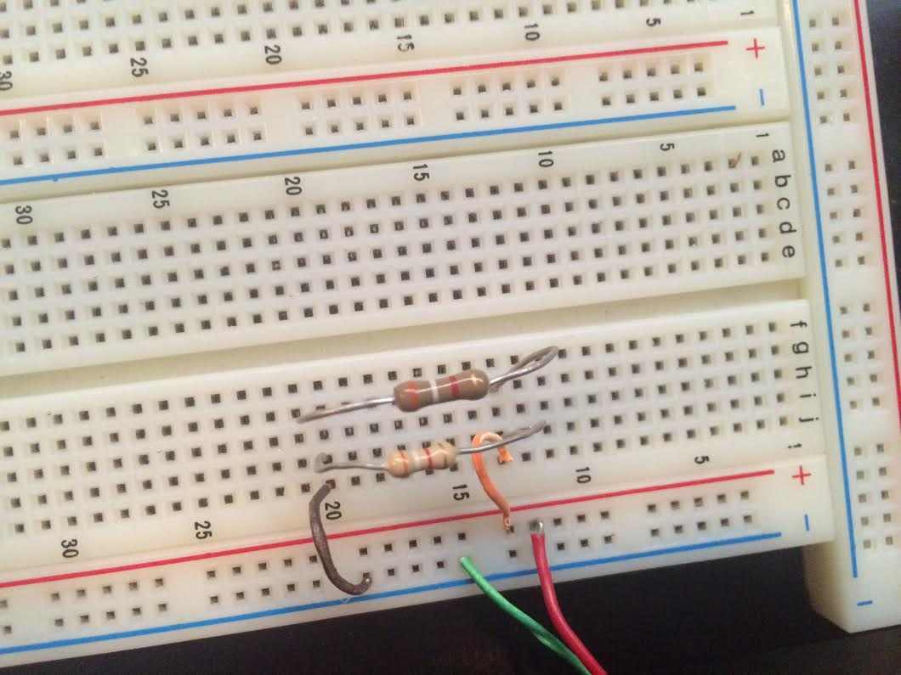
Lab 5 – Parallel Black Box Design (Pictures)
Three Resistors
in Parallel
Two Resistors
in Parallel

Slide 34

Lab 5 – Parallel Black Box Design (Conclusion)
All calculations, Multisim and measurements agreed with one another. I learned that, like the series black box, resistor choices are limited. However, because resistance divides in parallel, there can be more than one answer.
µ

Slide 35
Error 404: Lab 6 Not Found
This is a standard message from your Power Point indicating the file you are wanting to access doesn’t exist or isn’t available; basically it means a dead end…

Slide 36
Lab 7 – 4 Resistor Parallel Circuit
Star Date: 2/26/15

Slide 37

Lab 7 – 4 Resistor Parallel Circuit
Purpose: To learn about parallel circuits.
Equipment/Material: Four standard resistors, Digital MultiMate (DMM), and breadboard.
Procedure: Measure all four resistor values using a DMM and record, followed by the measuring of each branch current of the parallel circuit.

Slide 38

Lab 7 – 4 Resistor Parallel Circuit (Calculations)

Slide 39
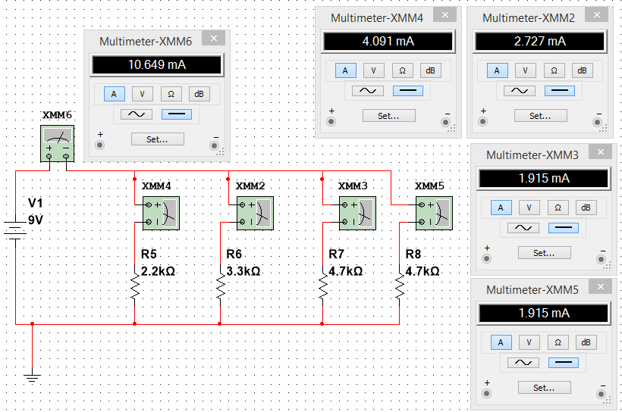
Lab 7 – 4 Resistor Parallel Circuit (Multisim)
I
R

Slide 40
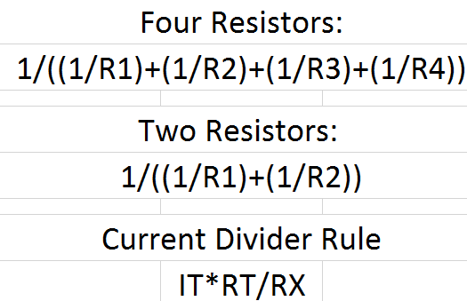
Lab 7 – 4 Resistor Parallel Circuit (Measurements)

Slide 41
Lab 7 – 4 Resistor Parallel Circuit (Pictures)

Slide 42
Lab 7 – 4 Resistor Parallel Circuit (Conclusion)
All calculations, simulations and measurements agreed. I learned how current divides in parallel circuits, and the amperes through each branch can vary depending on the resistors value.

Slide 43

Lab 8 - Black Box 3 Design
Star Date: 2/26/15

Slide 44
Lab 8 - Black Box 3 Design
Purpose: To learn about building a circuit that produces exactly 1.3V.
Equipment/Material: Three equal value resistors, 5KΩ potentiometer Digital Multimeter & NI Elvis II+ Board.
Procedure: Find three equal value resistors which make up the black box. Once this is achieved, a 5KΩ potentiometer (R1) is adjusted so that the output voltage becomes exactly 1.3V.

Slide 45

Lab 8 - Black Box 3 Design (Calculations)

Slide 46
Lab 8 - Black Box 3 Design (Multisim)

Slide 47
Lab 8 - Black Box 3 Design (Measurement)

Slide 48
Lab 8 - Black Box 3 Design (Pictures)
Before
After

Slide 49

Lab 8 - Black Box 3 Design (Conclusion)
All calculations, simulations and measurements agreed. I learned how a potentiometer works and the ways it is applied to circuits such as these.

Slide 50
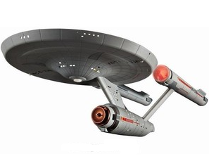
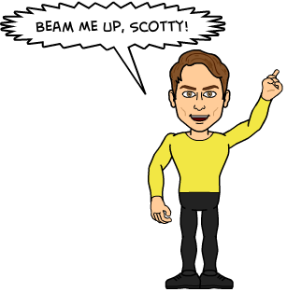

Lab 9 – Series/Parallel Resistors
Star Date: 3/26/15

Slide 51


Lab 9 – Series/Parallel Resistors
Purpose: To experiment with series circuits and verify that the simulation, analysis (calculations) and test results all agree.
Equipment/Material: Many varying resistors, Digital Multimeter (DDM) & NI Elvis II+ Board.
Procedure: Using a DDM, measure a series parallel circuit. Measure each resistor, and total resistance.

Slide 52
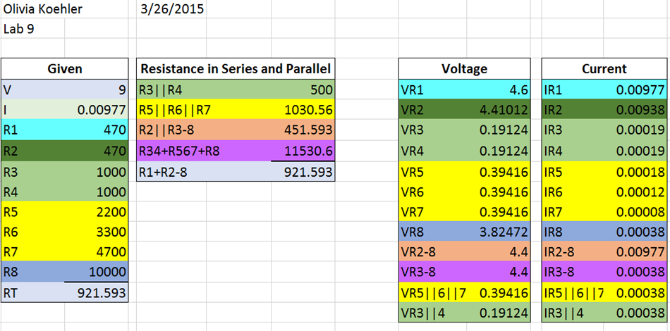
Lab 9 – Series/Parallel Resistors (Calculations)

Slide 53
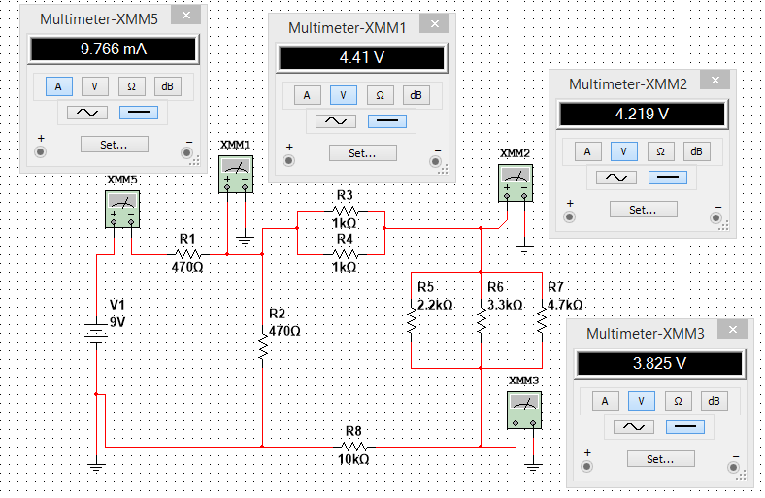
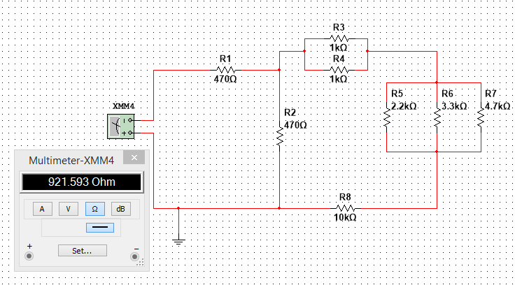
Lab 9 – Series/Parallel Resistors (Multisim)

Slide 54
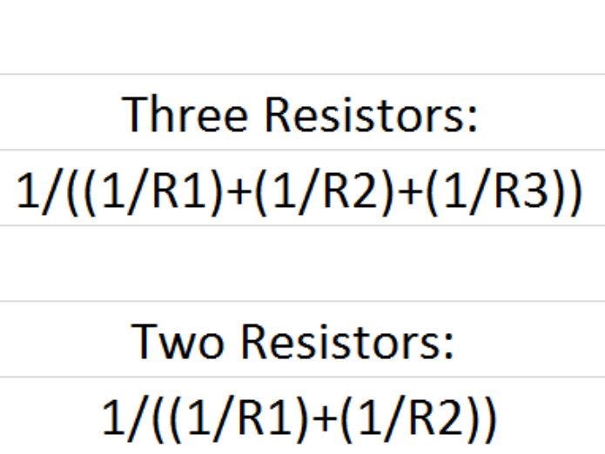

Lab 9 – Series/Parallel Resistors (Measurements)

Slide 55
Lab 9 – Series/Parallel Resistors (Pictures)

Slide 56
Lab 9 – Series/Parallel Resistors (Conclusion)
All calculations, simulations and measurements agreed each other. I learned how current divides and adds in series/parallel circuits. I also learned how to watch the resistors carefully when I am calculating parallel values in the circuit.

Slide 57

Lab 10 – Series & Parallel Capacitors
Star Date: 4/2/15

Slide 58
Lab 10 – Series & Parallel Capacitors
Purpose: To experiment with series and parallel combinations of capacitors.
Equipment/Material: Capacitors (10uF, 22uF and 47uF), LCR Meter and breadboard.
Procedure: Measure and record the capacitance of each capacitor with an LCR Meter. Then arrange the capacitors in series, then in parallel, and record the total capacitance.

Slide 59
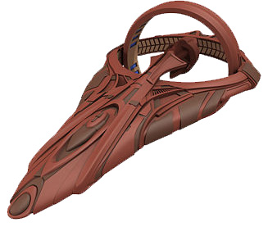
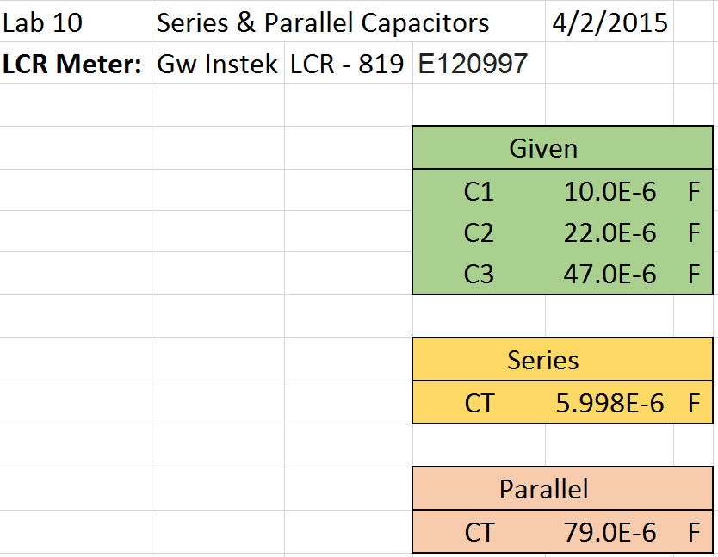
Lab 10 – Series & Parallel Capacitors (Calculations)

Slide 60
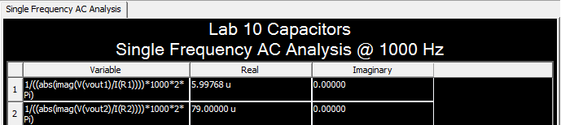
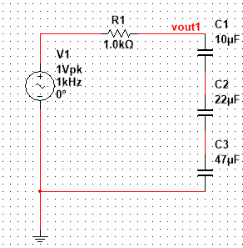
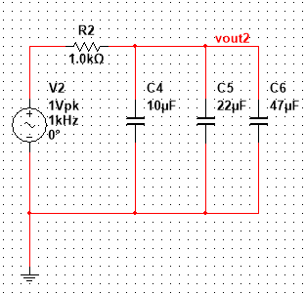
Lab 10 – Series & Parallel Capacitors (Multisim)

Slide 61
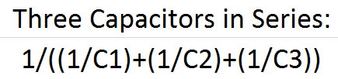
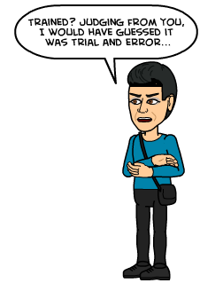
Lab 10 – Series & Parallel Capacitors (Measurements)

Slide 62
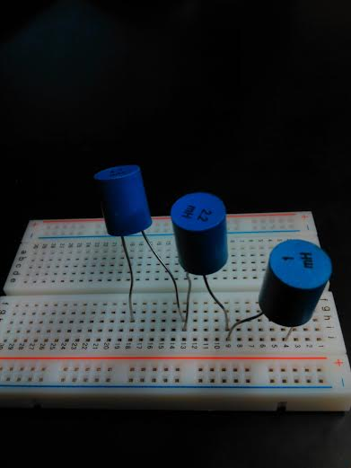
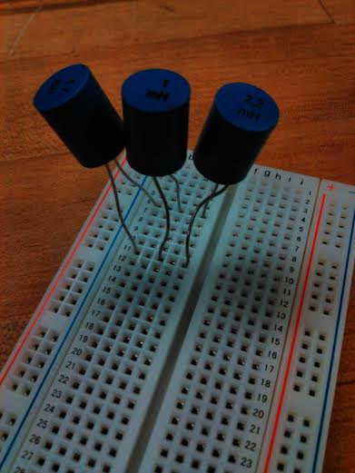
Lab 10 – Series & Parallel Capacitors (Pictures)
Series
Parallel

Slide 63
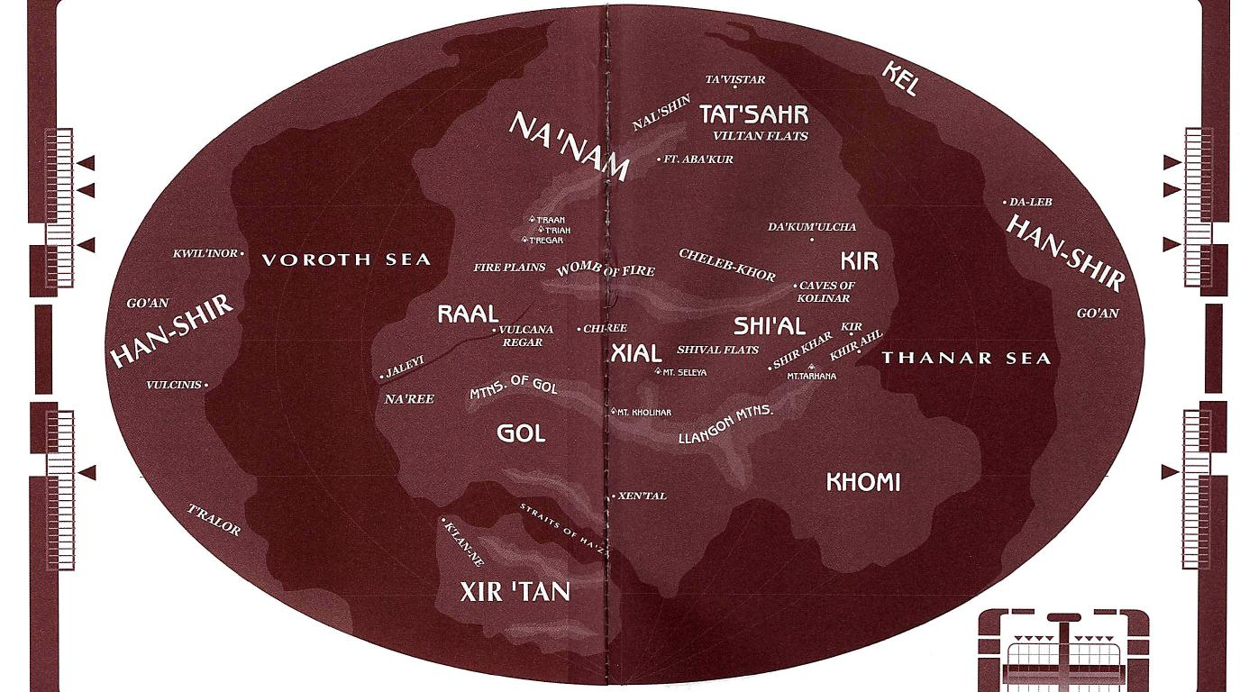

Lab 10 – Series & Parallel Capacitors (Conclusion)
All calculations, simulations and measurements agreed with one another. From doing this experiment, I learned that capacitors are the opposite of resistors when it comes to finding total capacitance. For example, resistors add in series where capacitors divide. Or, resistors divided in parallel where capacitors add.

Slide 64
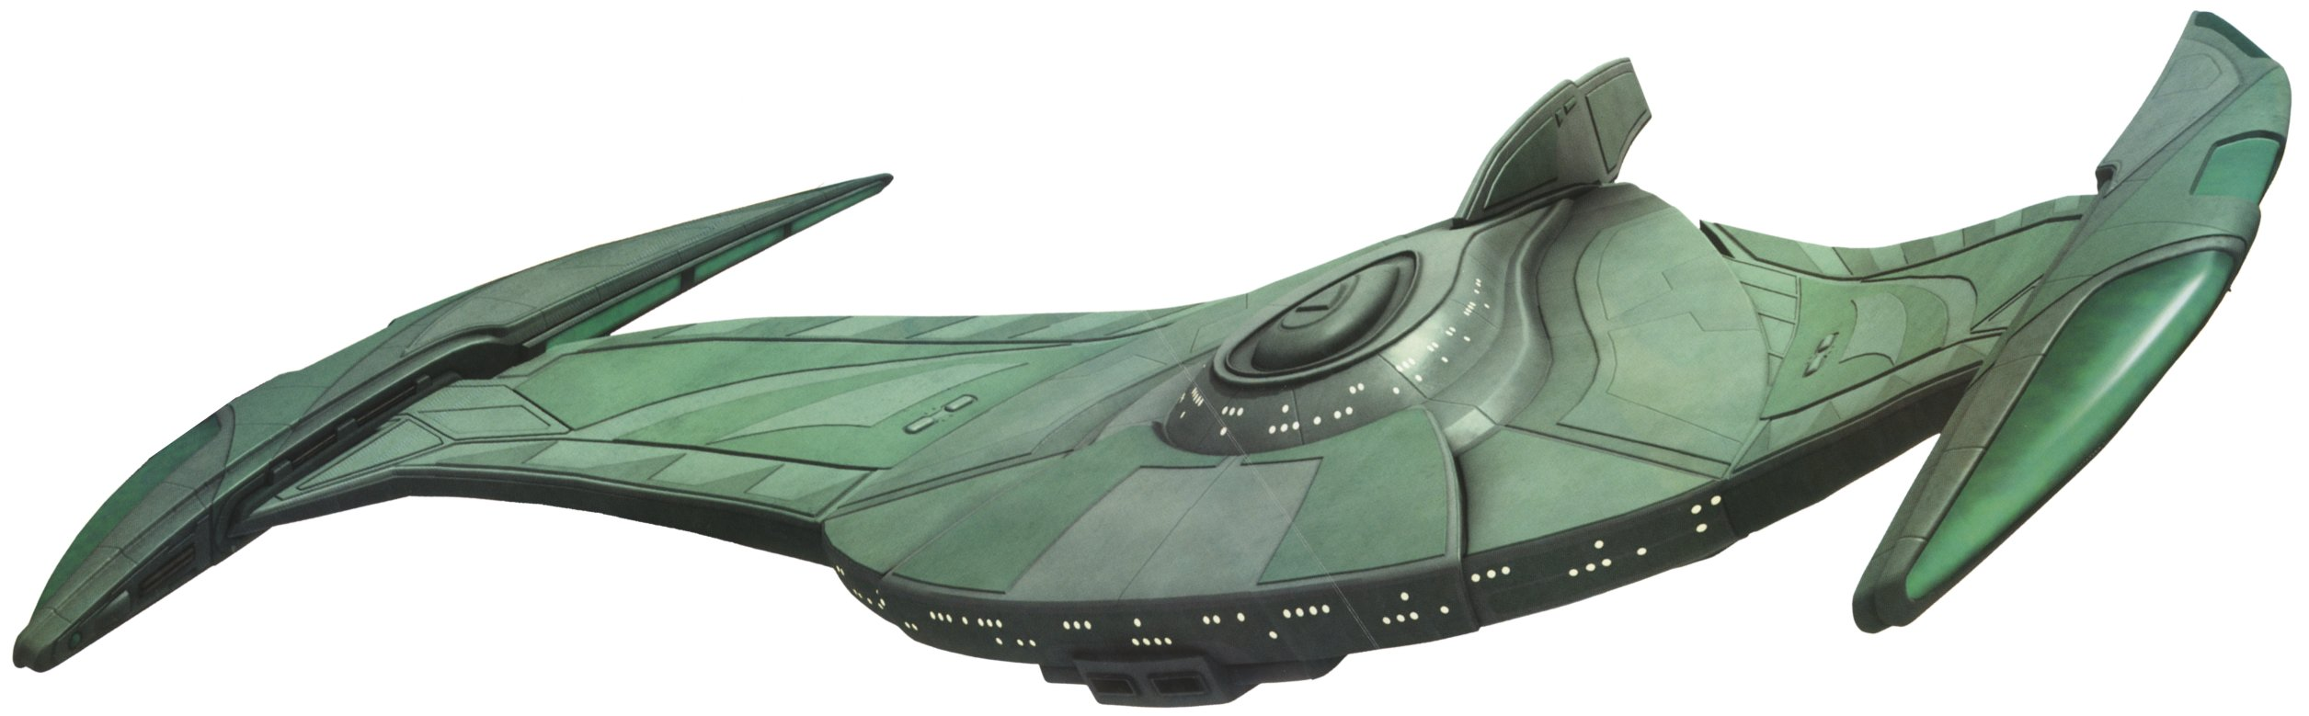
Lab 11 – RC Lab
Star Date: 4/9/15

Slide 65
Lab 11 – RC Lab
Purpose: To experiment with RC (Resistor & Capacitor) circuits.
Equipment/Material: Capacitors (0.47uF, 1uF and 2.2uF ), 1kΩ Resistor, LCR Meter, Digital Multimeter (DMM), Oscilloscope, a Function Generator and a breadboard. And a partridge in a pear tree.
Procedure: Measure and record the resistor using the DMM, as well as capacitors with an LCR Meter. After arranging the capacitor and resistor in series, as indicated by instructor, connect the circuit to the function generator. the Function Generator to the input at V1 and connect Channel 1 of the Oscilloscope to the input and Channel 2 to the output. Adjust and measure the voltage using the Oscilloscope.

Slide 66
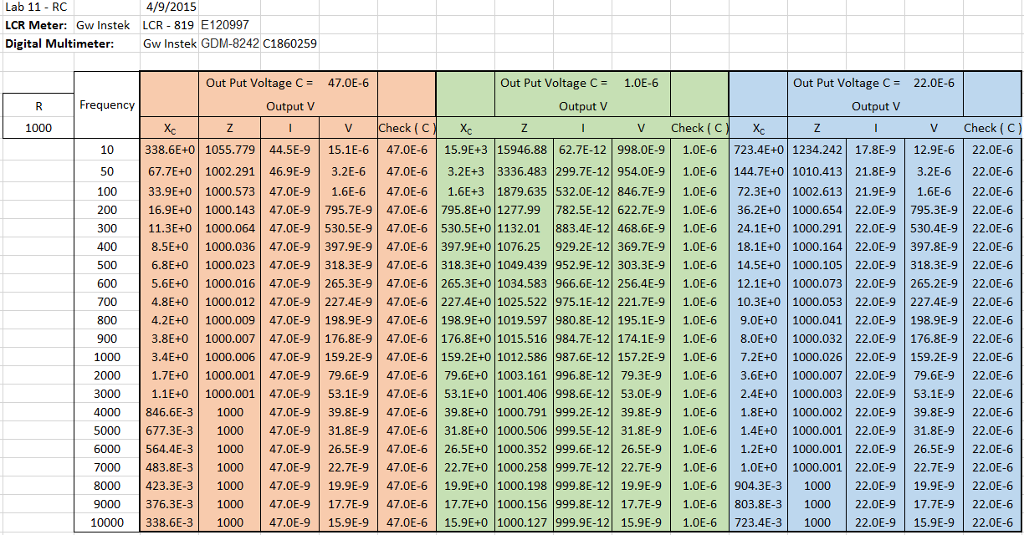
Lab 11 – RC Lab (Calculations)

Slide 67
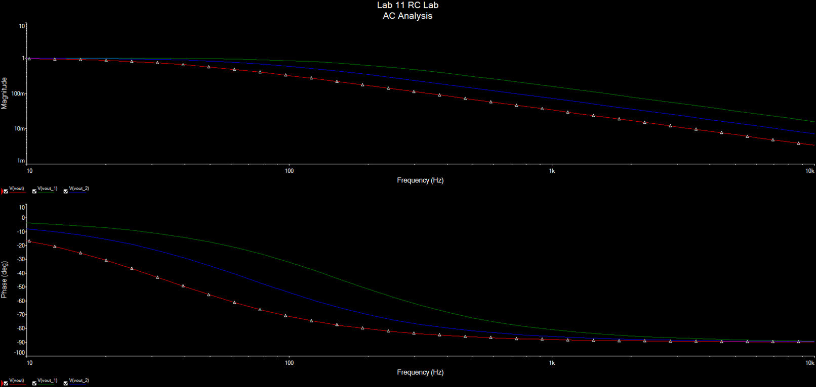
Lab 11 – RC Lab (Multisim)

Slide 68
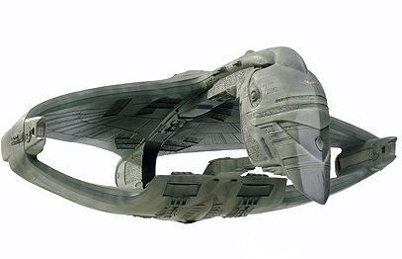
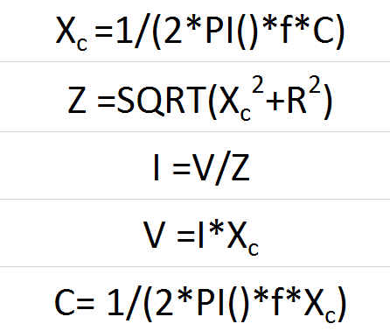
Lab 11 – RC Lab (Measurements)

Slide 69




Lab 11 – RC Lab (Pictures)
0.47uF
2.2uF
1uF

Slide 70

Lab 11 – RC Lab (Conclusion)
All calculations, simulations and measurements coincided. I learned about how frequencies affect a capacitor. This lab in particular took the longest, but because it was so involved I learned a lot about how the Oscilloscope works.

Slide 71

Lab 12 – Series & Parallel Inductors
Star Date: 4/23/15

Slide 72

Lab 12 - Series & Parallel Inductors
Purpose: To experiment with series and parallel combinations of inductors.
Equipment/Material: Inductors (1mH, 2.2mH and 4.7mH), LCR Meter and breadboard.
Procedure: Measure and record the inductance of each inductor, using an LCR Meter. Then arrange the inductors in series, then in parallel, and record the total inductance.

Slide 73


Lab 12 – Series & Parallel Inductors (Calculations)

Slide 74
Lab 12 - Series & Parallel Inductors (Multisim)

Slide 75
Lab 12 - Series & Parallel Inductors (Measurements)

Slide 76
Lab 12 - Series & Parallel Inductors (Pictures)

Slide 77
Lab 12 - Series & Parallel Inductors (Conclusion)
All calculations, simulations and measurements agreed with one another. I learned about how frequencies affect inductance, and how to measure it all with an LCR meter. Everything worked perfectly when hooked up with one another. There were no problems.

